Slide 1
ITSA線上程式競賽基礎題目
#36~40

Slide 2
題目36. 平、閏年判定
https://e-tutor.itsa.org.tw/e-Tutor/mod/programming/view.php?id=30753
運算思維: (課堂講解)
程式碼說明: (課堂講解)

Slide 3
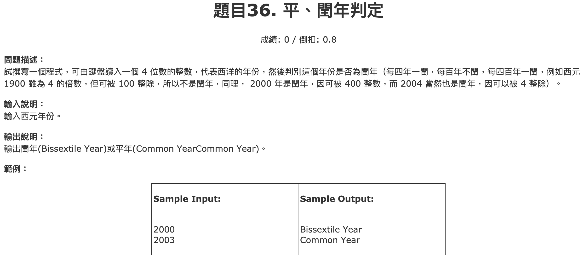

Slide 4
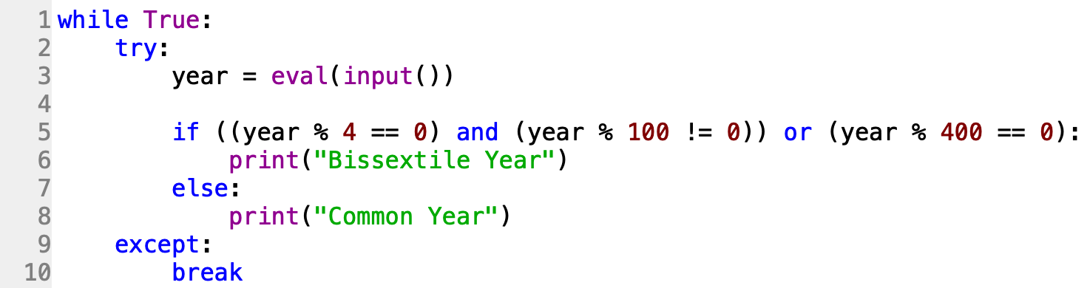

Slide 5
題目37. 18啦遊戲設計
https://e-tutor.itsa.org.tw/e-Tutor/mod/programming/view.php?id=30794
運算思維: (課堂講解)
程式碼說明: (課堂講解)

Slide 6
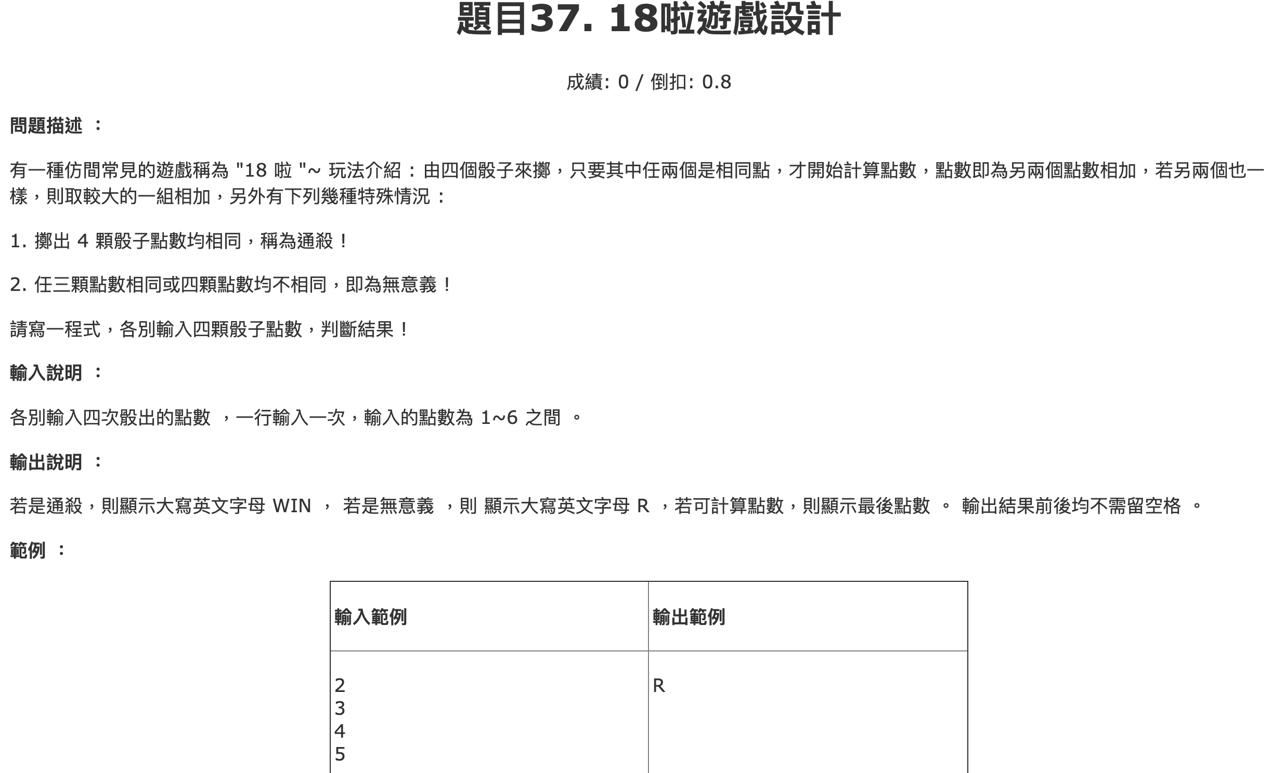

Slide 7
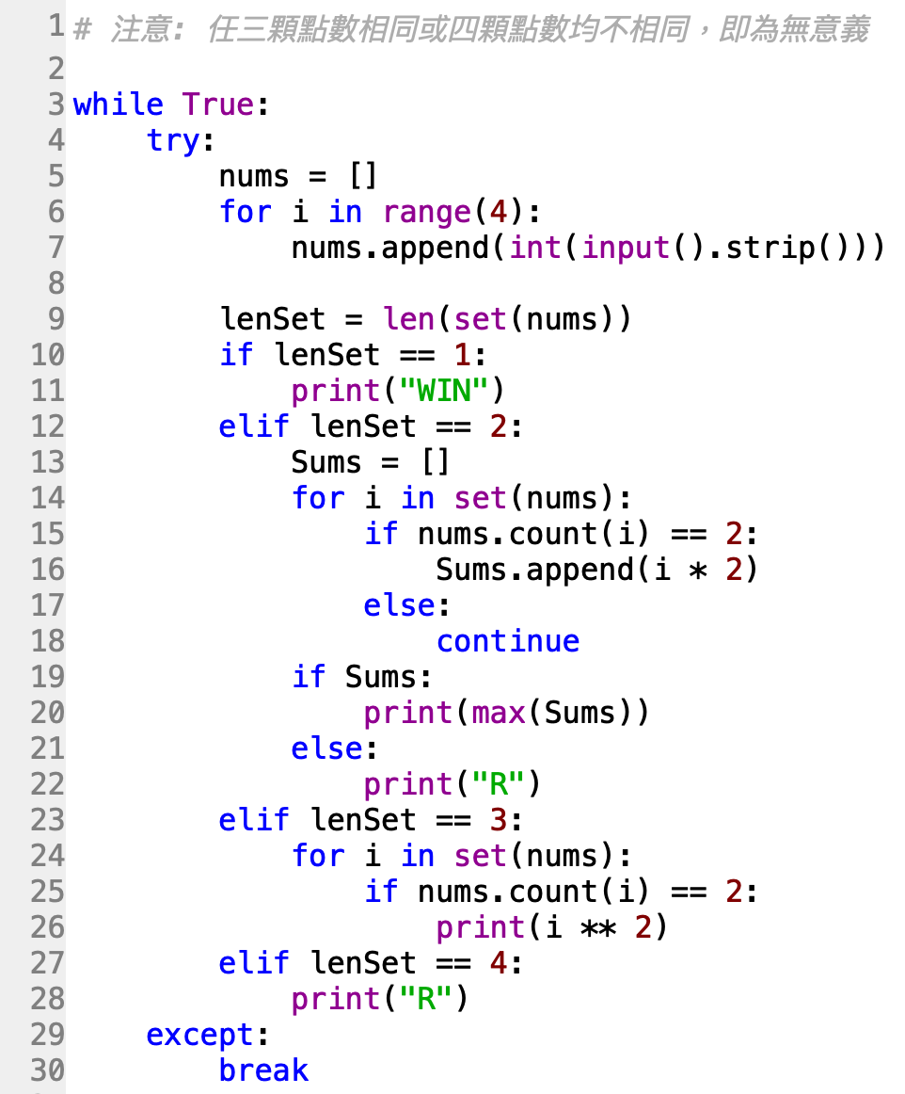

Slide 8
題目38. 計算電費
https://e-tutor.itsa.org.tw/e-Tutor/mod/programming/view.php?id=30795
運算思維: (課堂講解)
程式碼說明: (課堂講解)

Slide 9
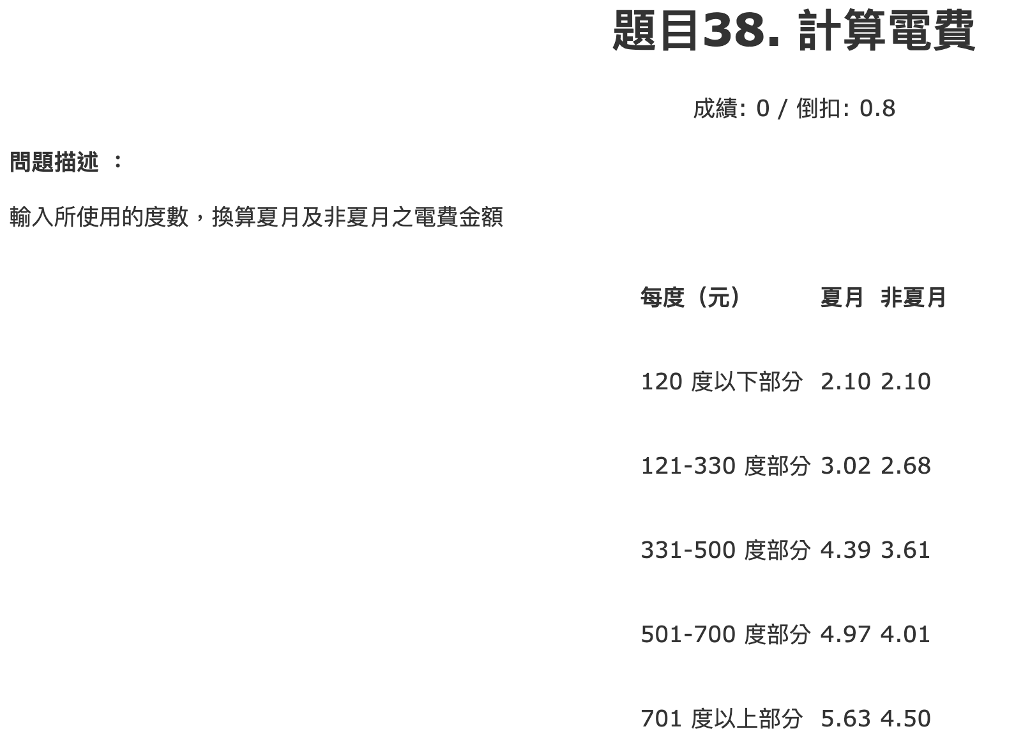

Slide 10
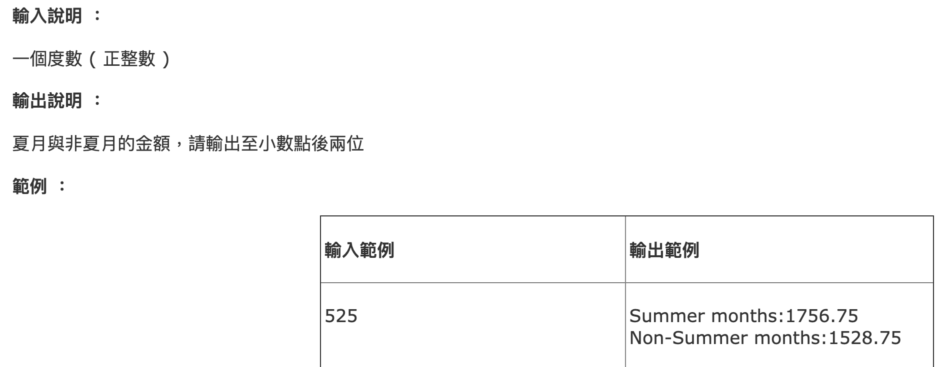

Slide 11
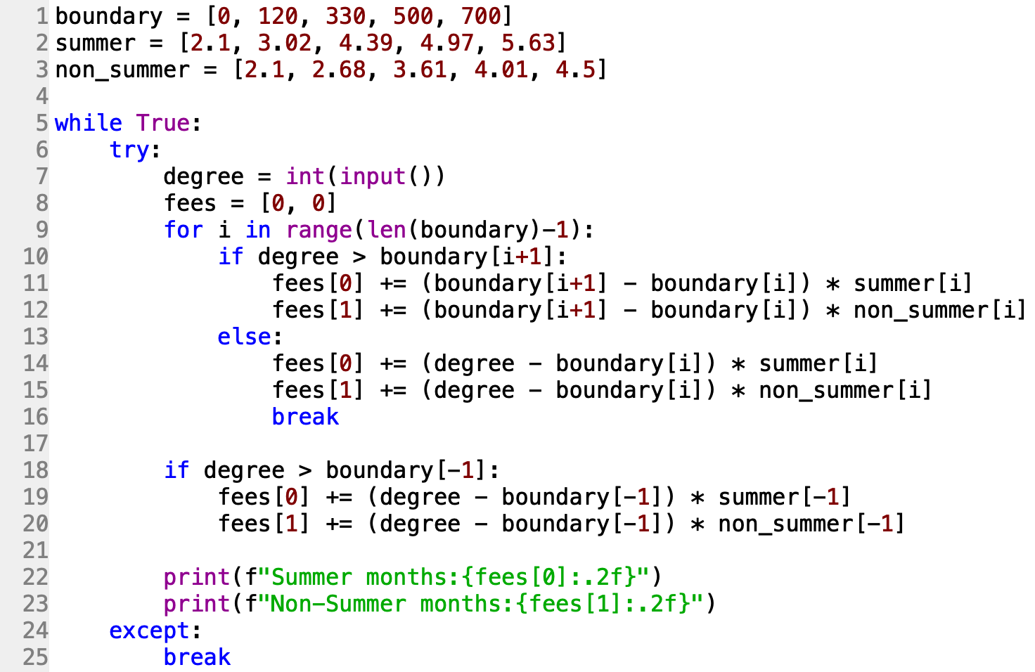

Slide 12
題目39. 考試測驗
https://e-tutor.itsa.org.tw/e-Tutor/mod/programming/view.php?id=30758
運算思維: (課堂講解)
程式碼說明: (課堂講解)

Slide 13
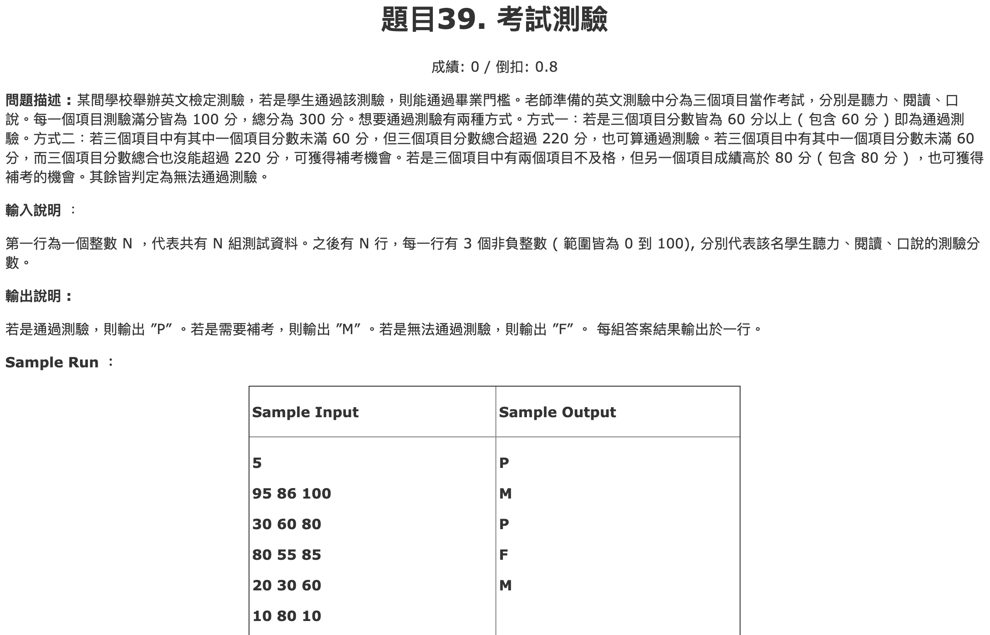

Slide 14
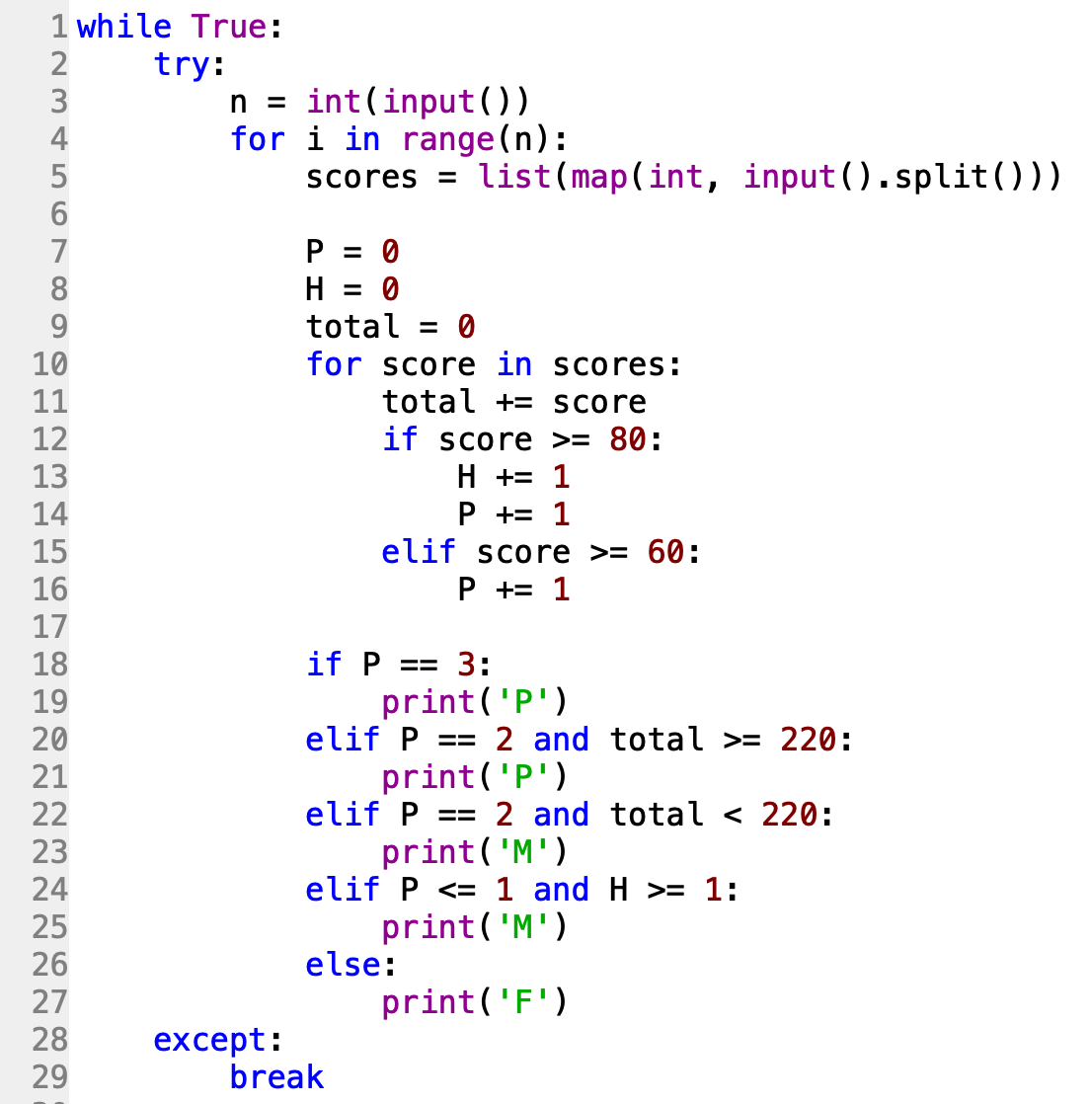

Slide 15
題目40. ISBN驗證
https://e-tutor.itsa.org.tw/e-Tutor/mod/programming/view.php?id=30796
運算思維: (課堂講解)
程式碼說明: (課堂講解)

Slide 16
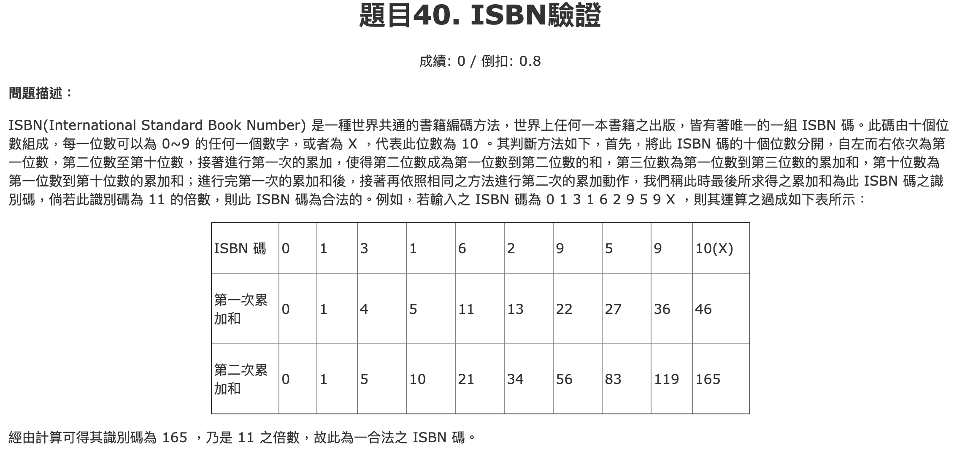

Slide 17
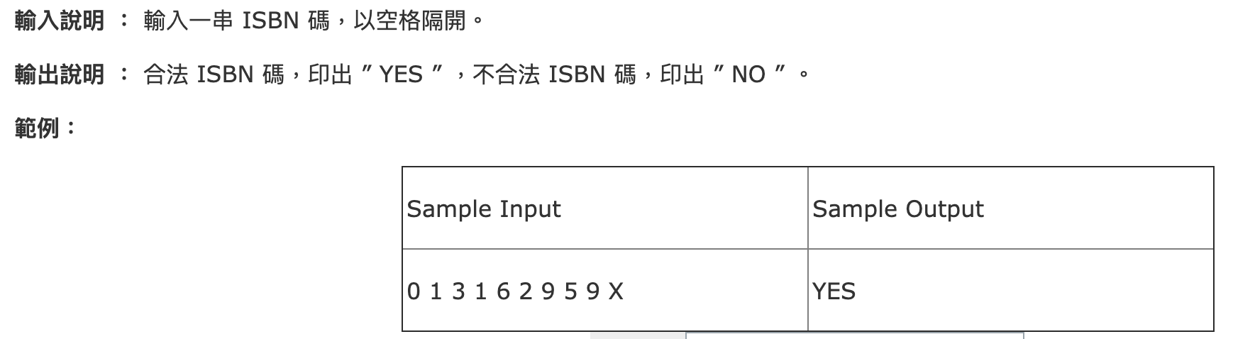

Slide 18
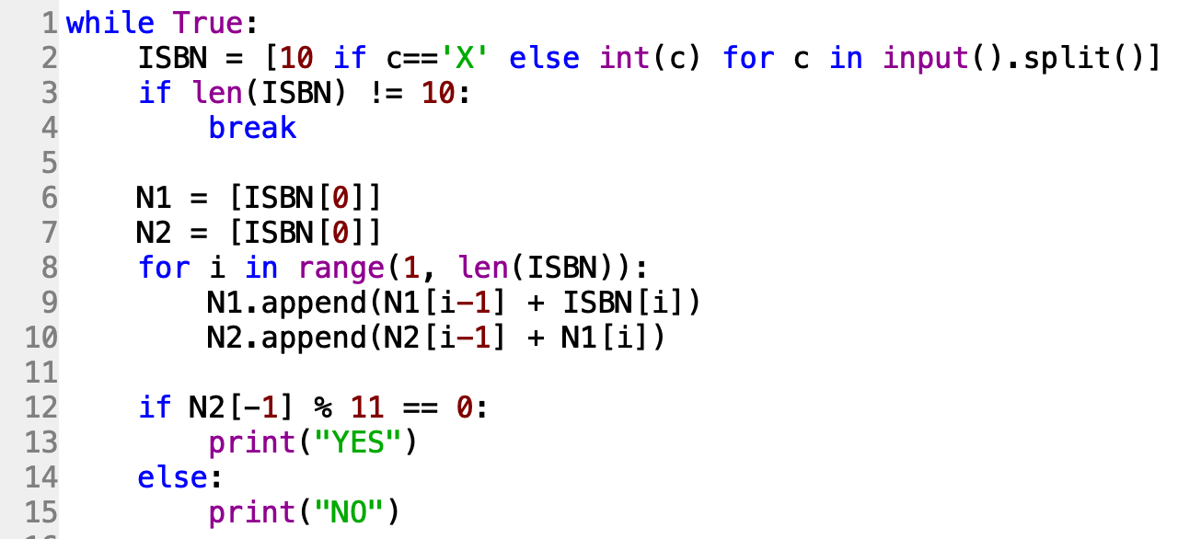
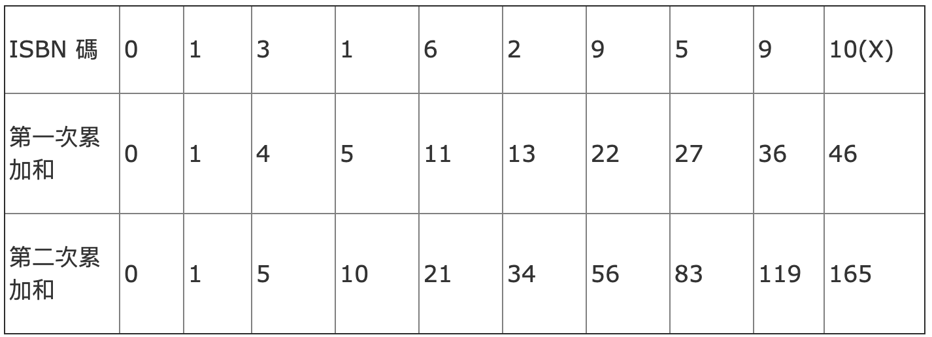

Slide 19
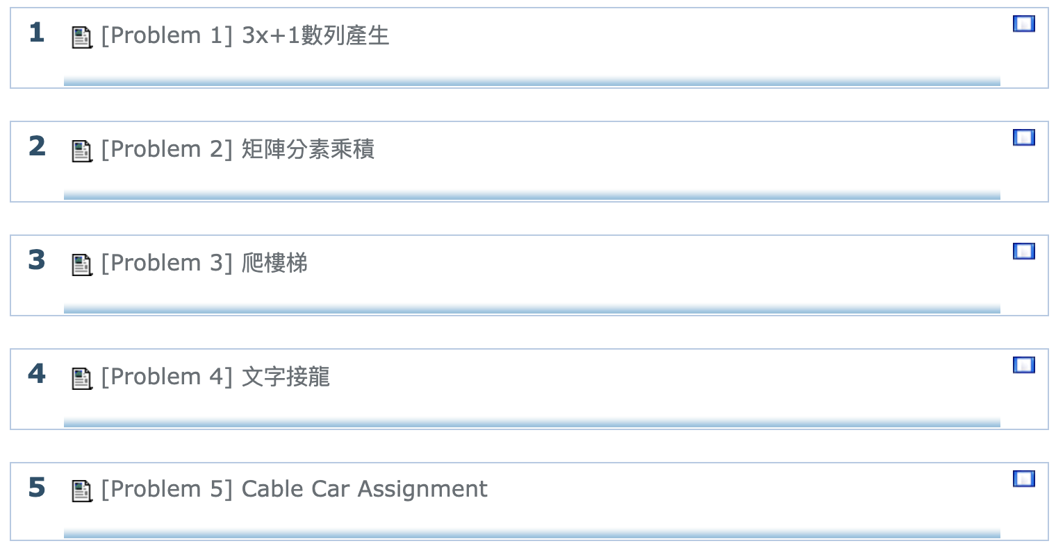
ITSA #39
https://e-tutor.itsa.org.tw/e-Tutor/course/view.php?id=1160

